Slide 1
SWAN- SMT Profile Verify Review
JBD-VN-ME
2022/02/14

Slide 2
96.1516T00-SMT profile to optimal
1.Reflow Profile optimal
Time-1
Profile feature | Fii suggest | Result
Ramp-up rate (Tsmax to Tp) | 3°C/second max | 0.88~0.92
Preheat Time (150-180°C) (ts) | 60-120 seconds | 94~99
Soldering time(TL>217°C) (tL) | 50-90 seconds | 82~87
Peak Temperature (Tp) | (Suggest 240-250°C) | 245.0~246.3
Time within 5°C of actual peak temperature (tp) | 20-40 seconds | 26~28
Ramp-down rate (Tp to Tsmax) | 3°C/second max | -0.91 ~ -0.82
Status | Mass Product Stencil 0.10 mm Solder Paste: KOKI S3X58-M500
 | Fail Q'Ty | Total | Defect rate
Void solder >30% | 4 | 400 | 1.00%
Solder ball | 5 | 400 | 1.25%
O-ring not seal | 0 | 400 | 0.00%
Time-2
Profile feature | Fii suggest | Result
Ramp-up rate (Tsmax to Tp) | 3°C/second max | 0.80~0.89
Preheat Time (150-180°C) (ts) | 60-120 seconds | 90~96
Soldering time(TL>217°C) (tL) | 50-90 seconds | 71~76
Peak Temperature (Tp) | (Suggest 240-250°C) | 245.1~247.8
Time within 5°C of actual peak temperature (tp) | 20-40 seconds | 26~29
Ramp-down rate (Tp to Tsmax) | 3°C/second max | -1.15 ~ -0.92
Status | Mass Product Stencil 0.10 mm Solder Paste: KOKI S3X58-M500
 | Fail Q'Ty | Total | Defect rate
Void solder >30% | 3 | 400 | 0.75%
Solder ball | 5 | 400 | 1.25%
O-ring not seal | 0 | 400 | 0.00%
Summary: Void Solder > 30% unable to improved 100%. Fii RD & ME will keep and monitor this issue.

Slide 3
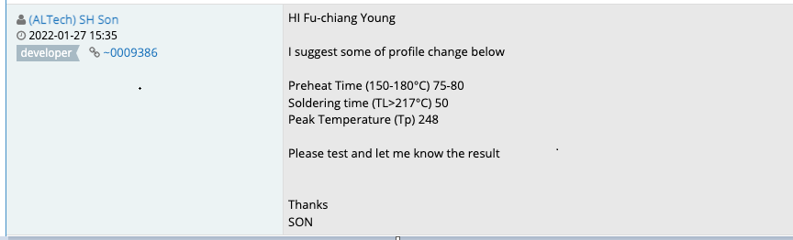
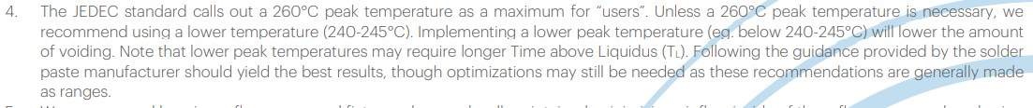
96.1516T00-SMT profile to optimal
2.Customer Profile suggest
2022/02/10
Vendor suggest profile for MIC
3.Fii Profile verify & optimal
Time-3
Profile feature | Fii suggest | Result
Ramp-up rate (Tsmax to Tp) | 3°C/second max | 0.94~0.98
Preheat Time (150-180°C) (ts) | 60-120 seconds | 88~96
Soldering time(TL>217°C) (tL) | 50-90 seconds | 88~90
Peak Temperature (Tp) | (Suggest 240-250°C) | 245.0~246.0
Time within 5°C of actual peak temperature (tp) | 20-40 seconds | 27~29
Ramp-down rate (Tp to Tsmax) | 3°C/second max | -1.05 ~ -0.86
Status | Mass Product Stencil 0.10 mm Solder Paste: KOKI S3X58-M500
 | Fail Q'Ty | Total | Defect rate
Void solder >30% | 3 | 400 | 0.75%
Solder ball | 6 | 400 | 1.50%
O-ring not seal | 0 | 400 | 0.00%
Summary: Void Solder > 30% unable to improved 100%. Fii RD & ME will keep and monitor this issue.
(Note: Some components cannot withstand temperatures exceeding 250 degrees when passing through the Reflow)

Slide 4
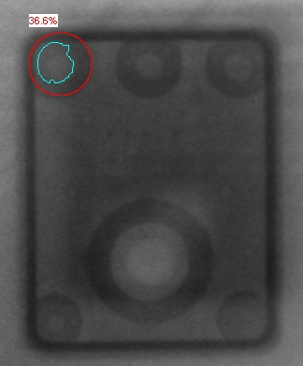
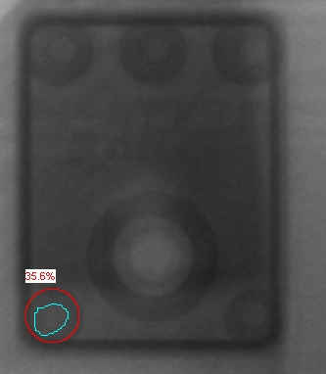
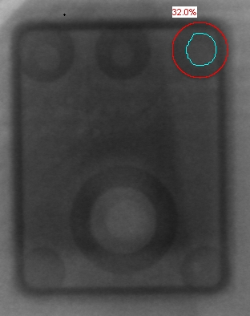
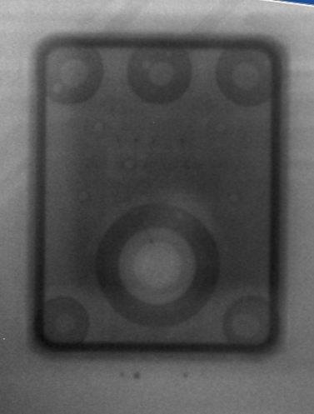
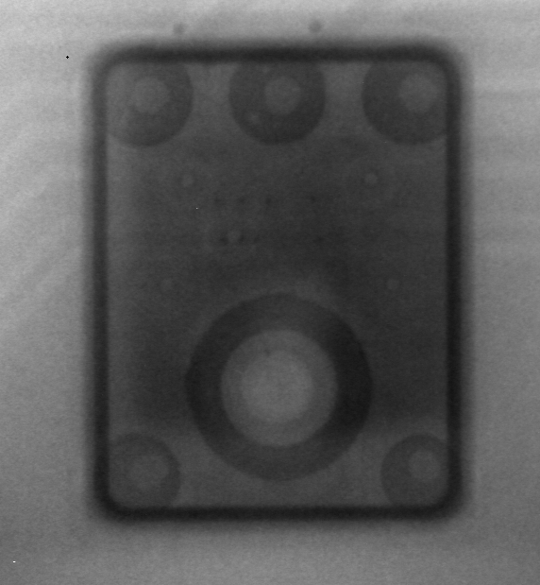
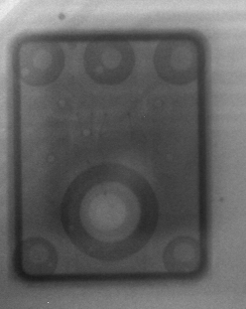
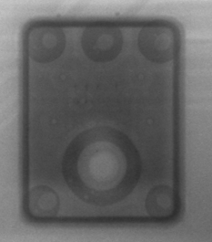
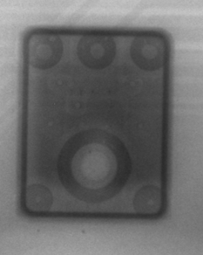
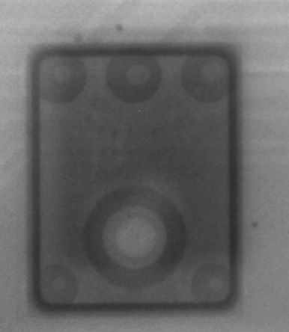
96.1516T00-SMT profile to optimal
5.X-Ray Image confirm.
Defect Type | 1 | 2 | 3 | 4 | 5 | 6
Solder Void Image
Solder Void | 36.6% | 35.6% | 32.0%
Solder Ball Image
Summary: Check for Void Solder > 30% an X-ray machine with an image as pictured (The biggest limit about: 36.6 %)

Slide 5
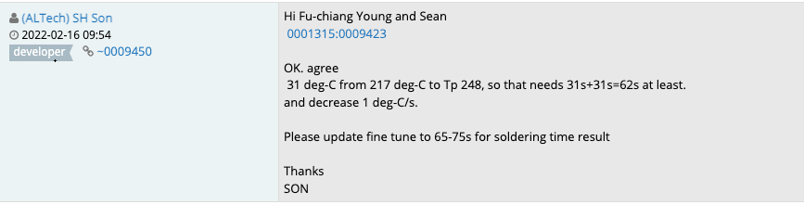
96.1516T00-SMT profile to optimal
6.Customer Profile suggest
2022/02/22
7.Fii Profile verify & optimal
Time-4
Profile feature | Fii suggest | Result
Ramp-up rate (Tsmax to Tp) | 3°C/second max | 1.00~1.09
Preheat Time (150-180°C) (ts) | 60-120 seconds | 98~100
Soldering time(TL>217°C) (tL) | 50-90 seconds | 71~72
Peak Temperature (Tp) | (Suggest 240-250°C) | 248.2~248.7
Time within 5°C of actual peak temperature (tp) | 20-40 seconds | 26~28
Ramp-down rate (Tp to Tsmax) | 3°C/second max | -1.34 ~ -1.56
Status | Mass Product Stencil 0.10 mm Solder Paste: KOKI S3X58-M500
 | Fail Q'Ty | Total | Defect rate
Void solder >30% | 3 | 400 | 0.75%
Solder ball | 7 | 400 | 1.75%
O-ring not seal | 0 | 400 | 0.00%
Summary: Void Solder > 30% unable to improved 100%. Fii RD & ME will keep and monitor this issue.
(Note: Some components cannot withstand temperatures exceeding 250 degrees when passing through the Reflow)

Slide 6
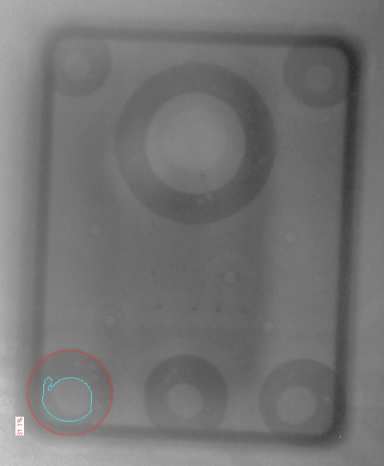
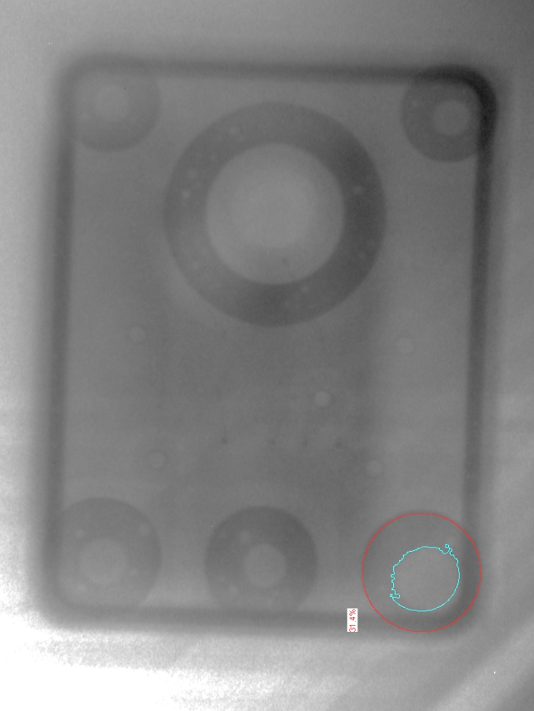
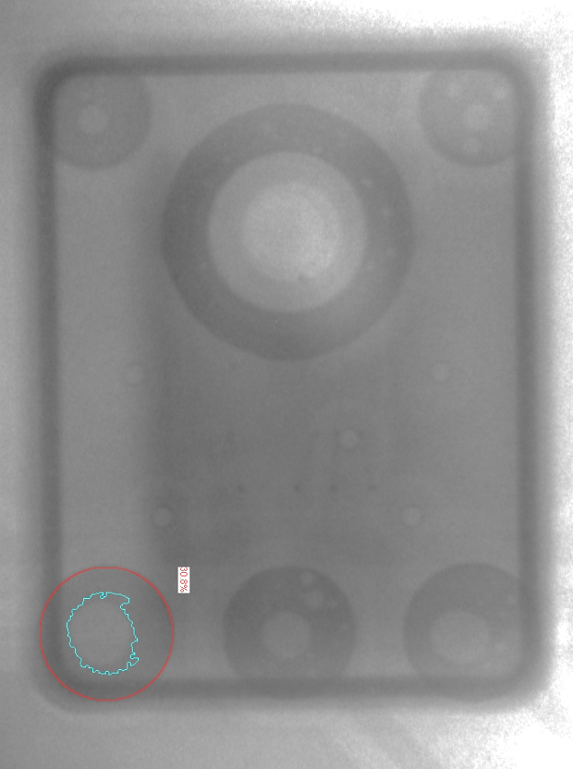
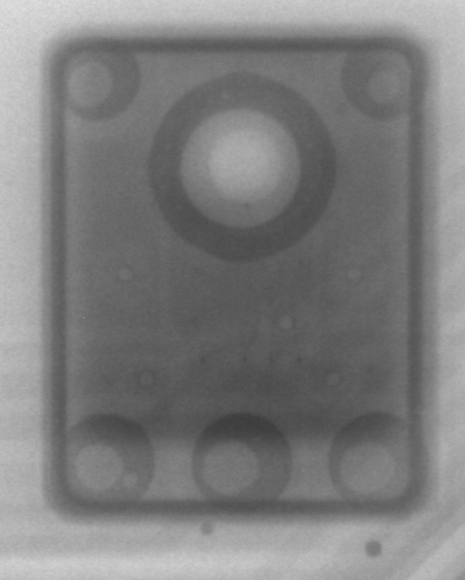
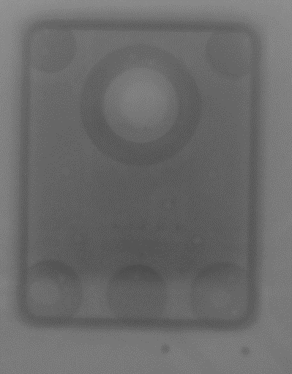
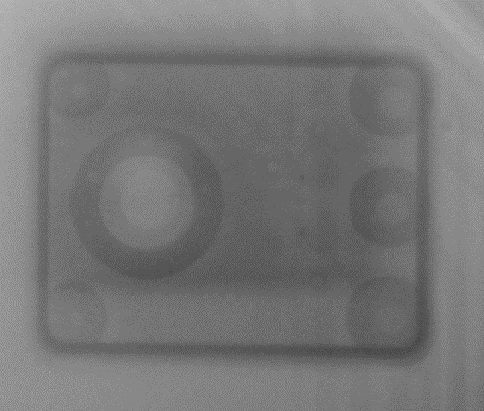
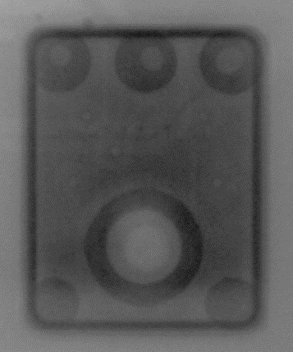
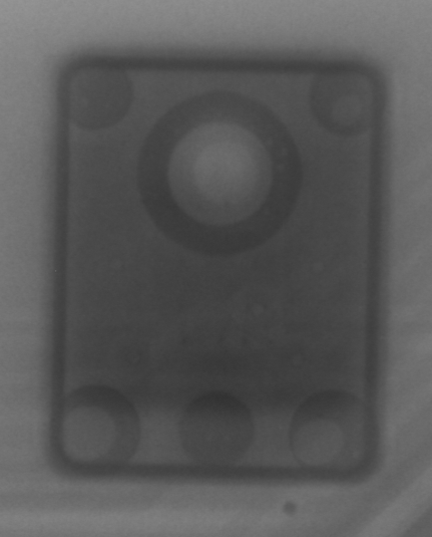
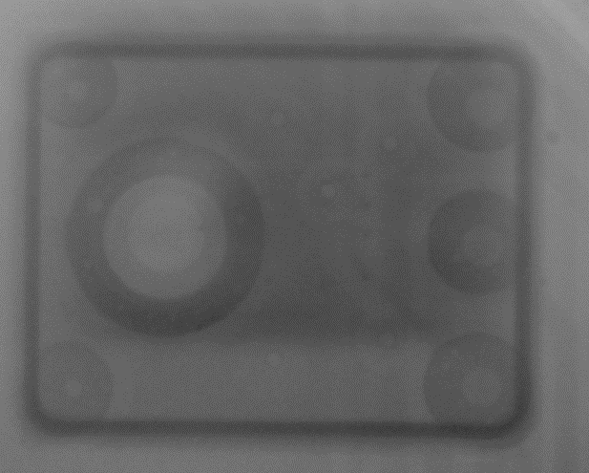
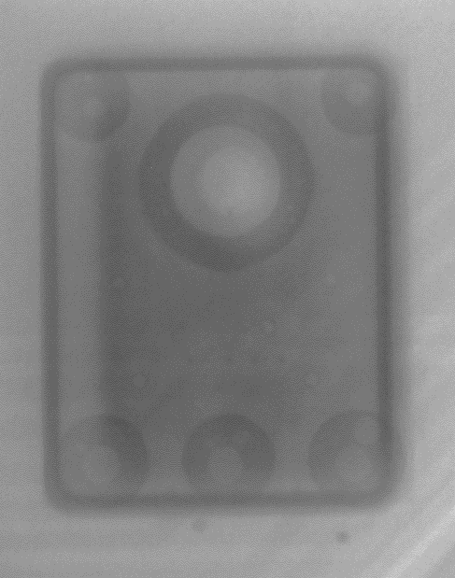
96.1516T00-SMT profile to optimal
8.X-Ray Image confirm.
Defect Type | 1 | 2 | 3 | 4 | 5 | 6 | 7
Solder Void Image
Solder Void | 31.4% | 31.1% | 30.8%
Solder Ball Image
Summary: Check for Void Solder > 30% an X-ray machine with an image as pictured (The biggest limit about: 31.4 %).

